Slide 1
Orientation
Kincardine Minor Baseball

Slide 3
Full Onboarding Session from Baseball Canada 10:00-49:00 most pertinent

Slide 6
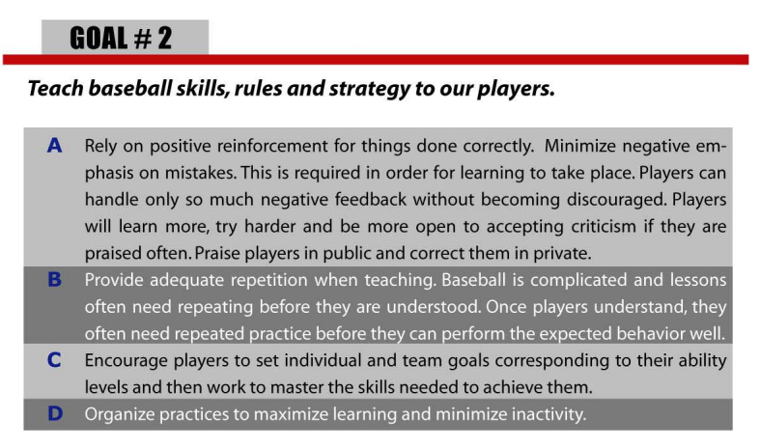

Slide 7
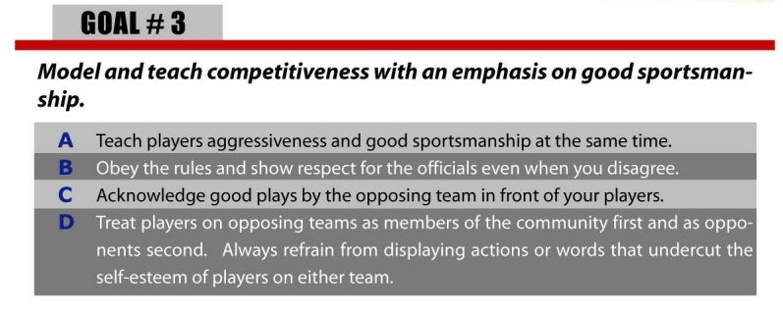

Slide 8
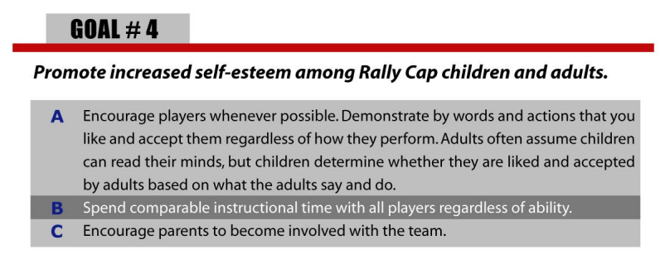

Slide 9
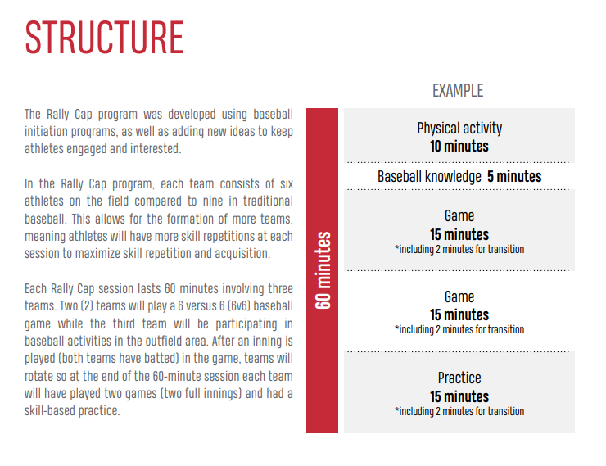

Slide 14
Rally Cap Season
Session 1
Rally Cap Day, gather baseline
Uniform pick-up
Get to know the team
Session 2-11
Developing skills and playing games
Session 12
Rally Cap Day, celebrate progress
Progress reports handed out

Slide 15
NOTE TO PARENTS AND COACHES:
Rally Cap is designed to optimize the number of opportunities that players have to touch the ball. In order to do this, teams have only 6-9 players.
With summer holiday schedules there may be weeks with low attendance however teams should only be combined if there are fewer than 3 players. Players should be combined with the remaining team that has the fewest players.

Slide 16
NOTE TO PARENTS AND COACHES:
Parents are expected to be involved in their child(ren)’s Rally Cap experience. The program will be most successful when there are several adults available for each team to help guide players and keep them engaged. Coaches are volunteers and many will have summer holidays that conflict with Rally Cap. The program is very straightforward and as such, there may be times when parents are expected to run sessions in the absence of the team coach.

Slide 17
Rally Cap Evaluations
1 evaluation at beginning of season to determine baseline
1 evaluation at end of season to celebrate success
Rally Cap day is a chance for players to showcase their
individual skills, set goals and celebrate their individual
growth over the course of the season
The day is set up in stations:
Hitting station
Throwing station
Receiving station
Baserunning station
Agility/Balance/Coordination station
The progress report is meant to provide players and parents with a list of skills they are working on. It is meant to be a positive experience and not to be viewed as a “test” or in any sort of negative light.

Slide 18
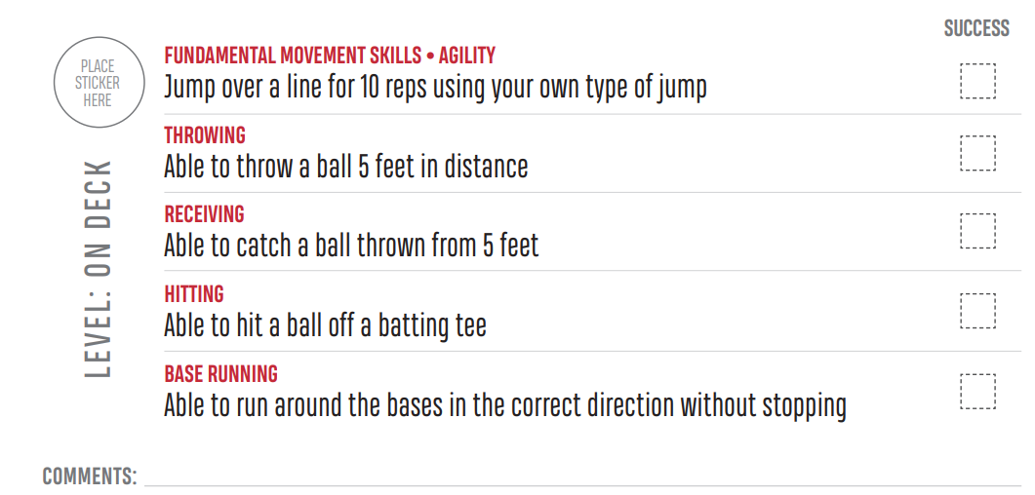

Slide 19
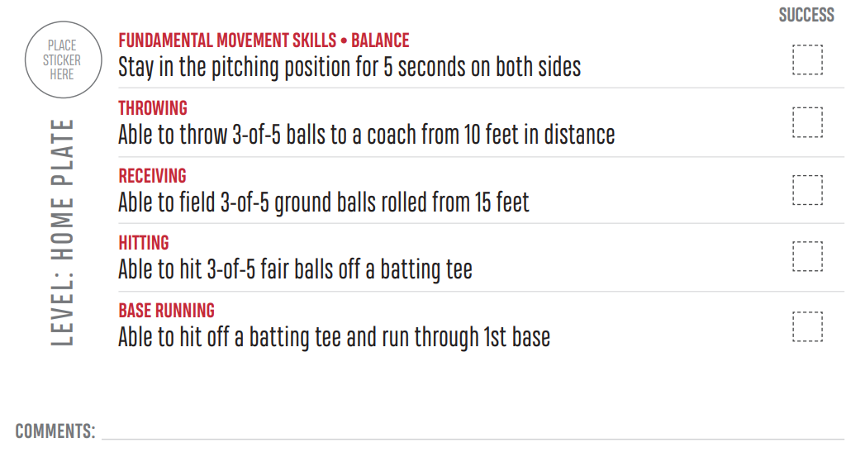

Slide 21
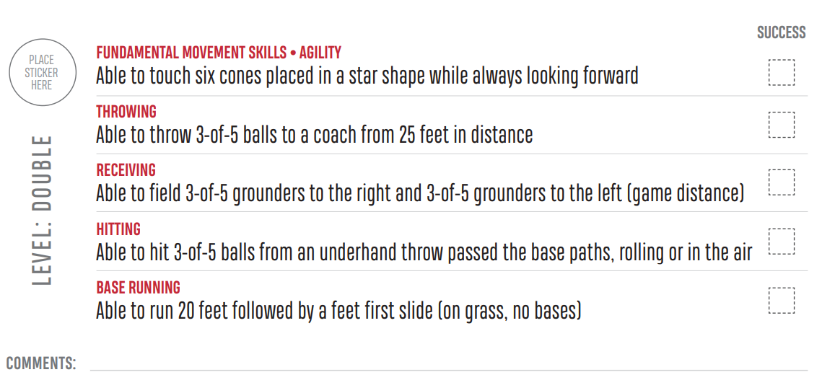

Slide 22
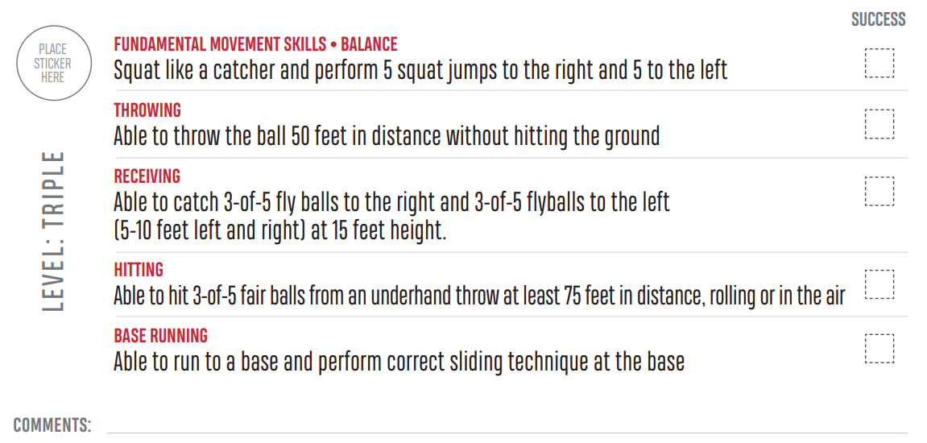

Slide 23
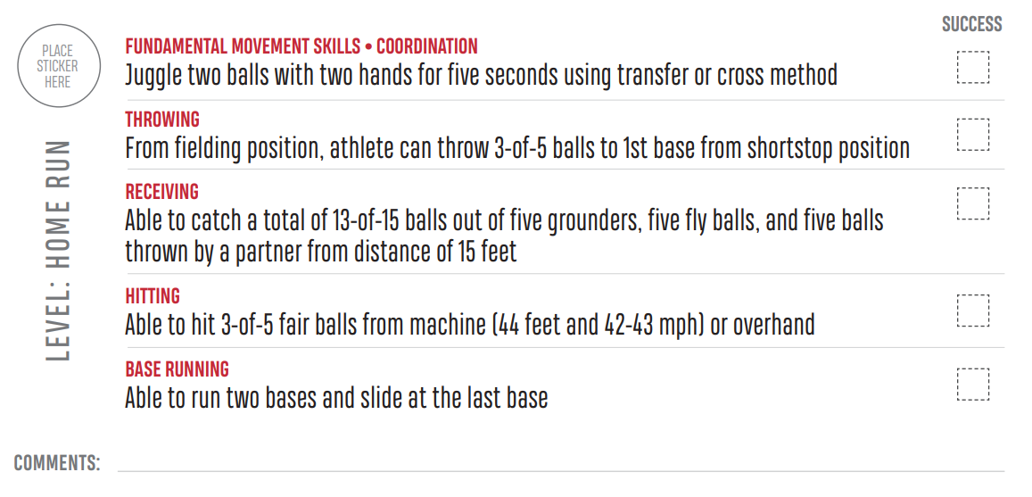

Slide 24
Thank you for your commitment to Kincardine Minor Baseball.

